Slide 1
Introduction to Deep Learning
Jen-Ing Hwang
Department of Computer Science and
Information Engineering

Slide 2
Outline
ANN: Biological Inspiration
Deep Learning?
Applications
Deep Neural Networks
Convolutional Neural Networks
Recurrent Neural Networks
Generative Adversarial Networks
Autoencoders

Slide 3
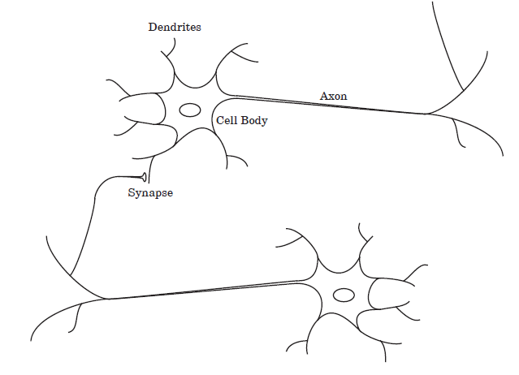
ANN: Biological Inspiration
Biological motivation
Biological learning system (brain)
Complex network of neurons

Slide 4
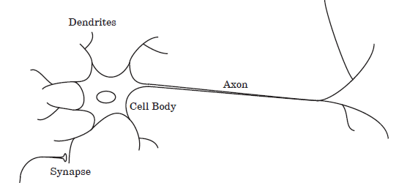
Artificial Neuron
Biological Neuron
Artificial Neuron
x₀ ≡ 1
x₁
Bias: w₀
Cell body
w₁
Input signals: x_{i}
x₂
w₂
Output signal: a = f(n)
n
f(n)
w_{M}
x_{M}
Weights: w_{i}
Dendrites (樹突)
Input signals (x_{i})
Synapses (突觸)
Weights (w_{i})
Cell Body (細胞體)
Cell Body (n, f(n))
Axon (軸突)
Output signal (a)

Slide 5
Deep Learning?
AI (Artificial Intelligence)
ML (Machine Learning)
ANN (Artificial Neural Networks人工神經網路)
DL (Deep Learning)
AI
ML
ANN
DL

Slide 6
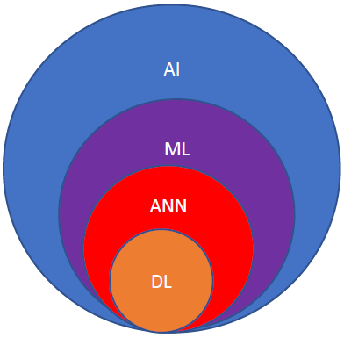
AI and ML
AI is a branch of computer science emphasizing the simulation(模擬) of human intelligence.
ML is a subfield of AI dealing with the problem of constructing algorithms of acquiring knowledge through observed data/experiences.

Slide 7
ANN and DL
ANN is part of a broader family of ML methods inspired by biological neural systems(生物神經網路).
資料在高維度的轉換當中，可以去萃取出足夠而抽象的資訊，去進行預測
深度學習只是將特徵-特徵之間的轉換模式以 層-層 之間的轉換實現，而高維的特徵向量以 層 的形式呈現。所以越深的網路代表著經過多次的函數處理跟萃取，所萃取的資訊的抽象程度越高，抽象程度越高，就越接近人類所想像的。
DL is a computational model based on ANN with representation learning.
Representation learning is learning representations of input data that make it easier to extract useful information when performing classifications or predictions.

Slide 8
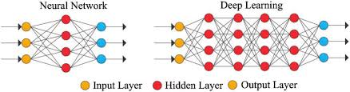
ANN and DL

Slide 9
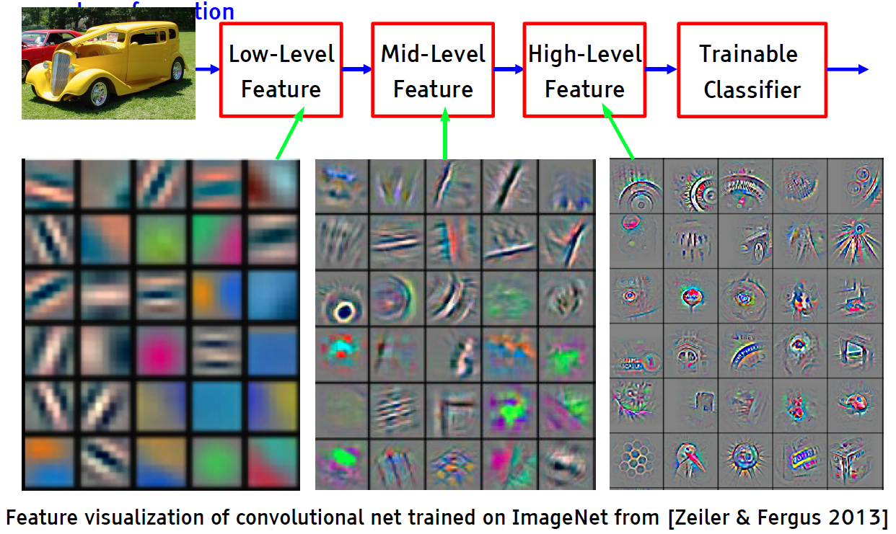
Deep Learning = Learning Hierarchical(分層的) Representations

Slide 10
Why Deep Learning? 為什麼要學深度學習
Hardware 硬體
Increase compute power 增加計算能力
For example: GPU (圖形處理器(=顯卡))
Algorithms 演算法
Progress in algorithms
Data 資料
Collections of great volume data from various sources are available

Slide 11
Applications應用
The applications are expanding because Deep Learning are good at solving problems, not just in engineering(工程), science(科學), and mathematics(數學), but in medicine(醫學), business(商業), finance(金融), and literature(文學) as well.
For example:
character recognition(字符識別),
text classification(文本分類)and categorization,
medical and health care(醫療和保健),
diagnosis(診斷),
computer vision(電腦視覺),
speech recognition(語音識別),
natural language processing(自然語言處理),…

Slide 12

Convolutional (卷積) Neural Networks

Slide 13
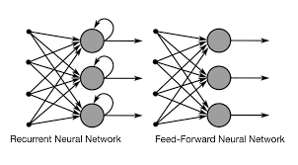
Recurrent Neural Networks

Slide 14
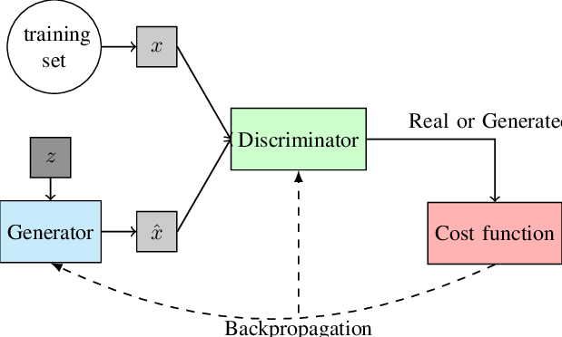
Generative Adversarial Networks(生成對抗網絡)

Slide 15
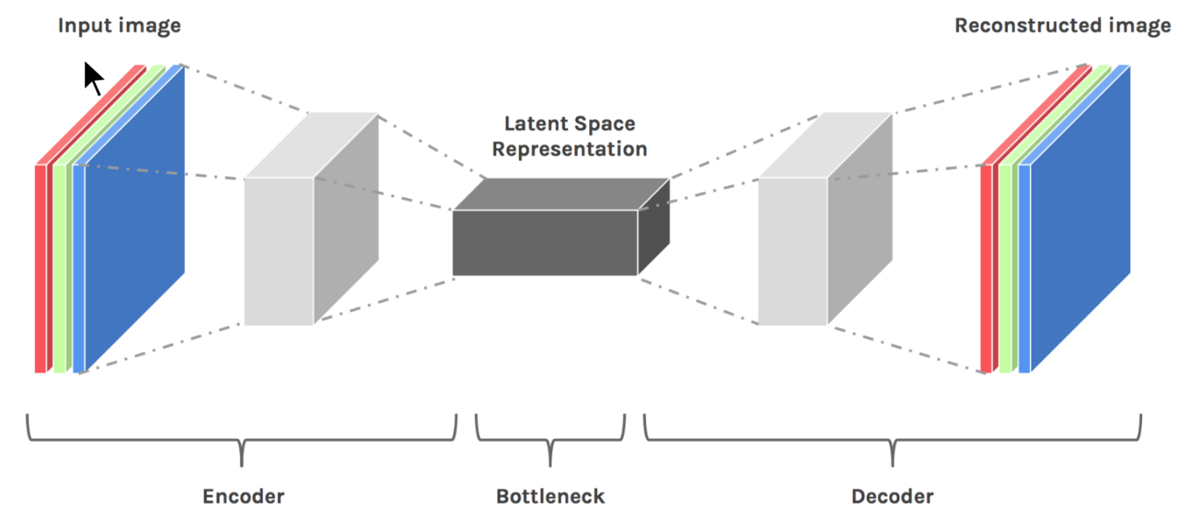
Autoencoders(自動編碼器)

